Slide 1
Functional Techniques for C#
Kathleen Dollard
Microsoft
@kathleendollard
kdollard@microsoft.com

Slide 2
You are effective with the imperative, object-oriented core of Java or .NET but you look longingly at the winsome smile of functional languages.
If you play with your language’s functional features, you’re never quite sure if you’re getting it right or taking full advantage of them. This talk is for you.
You’ll learn which code to attack with functional ideas and how to do it. You’ll look at code similar to what you write every day, and see it transform from long, difficult-to-follow code to short code that’s easy to understand, hard to mess up, and straightforward to debug. Better yet, functional approaches help you apply patterns in a clear and consistent way.
Apply these techniques while leveraging delegates, lambda expressions, base classes and generics.

Slide 3
You are effective with the imperative, object-oriented core of Java or .NET but you look longingly at the winsome smile of functional languages.
If you play with your language’s functional features, you’re never quite sure if you’re getting it right or taking full advantage of them. This talk is for you.
You’ll learn which code to attack with functional ideas and how to do it. You’ll look at code similar to what you write every day, and see it transform from long, difficult-to-follow code to short code that’s easy to understand, hard to mess up, and straightforward to debug. Better yet, functional approaches help you apply patterns in a clear and consistent way.
Apply these techniques while leveraging delegates, lambda expressions, base classes and generics.

Slide 4
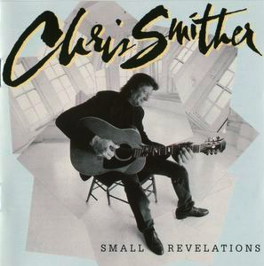
Winsome Smile Chris Smither Small Revelations album
Winsome –
“attractive or appealing in appearance or character.”
- Defined by Google

Slide 5
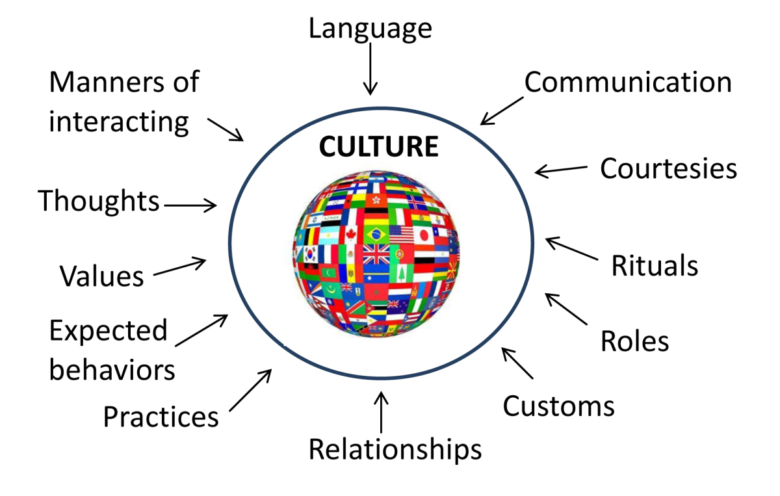
This Photo by Unknown Author is licensed under CC BY-NC-ND

Slide 6
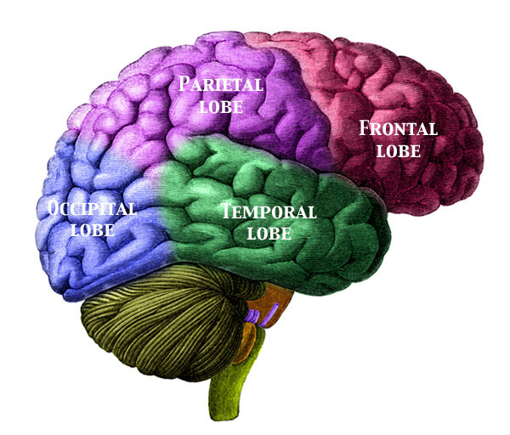
Culture and language have a great impact on how you think

Slide 7
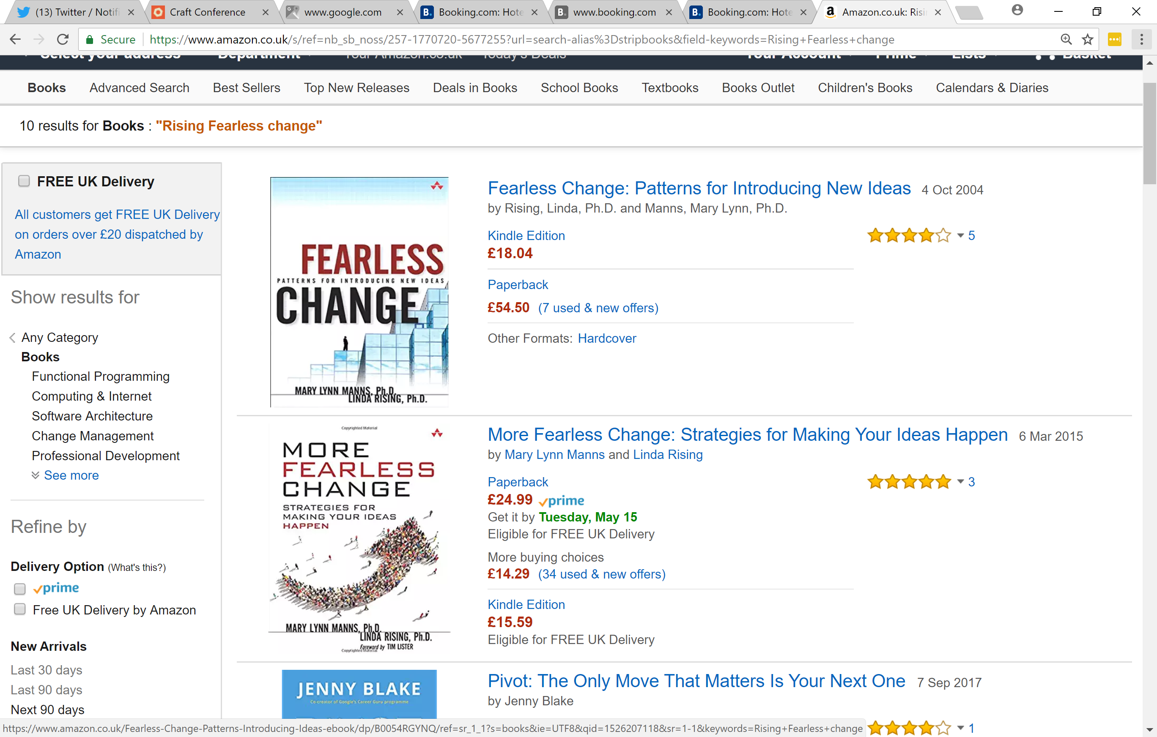
Linda Rising
You, your team, and your organization are complex adaptive systems
Complex adaptive systems cannot be changed by large forces, at least not effectively
They change because of small steps – small trials and adjustments

Slide 8
Technology drives fashion

Slide 9
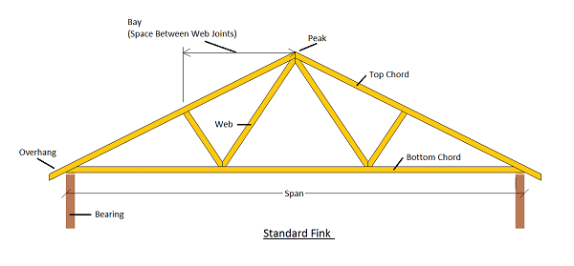
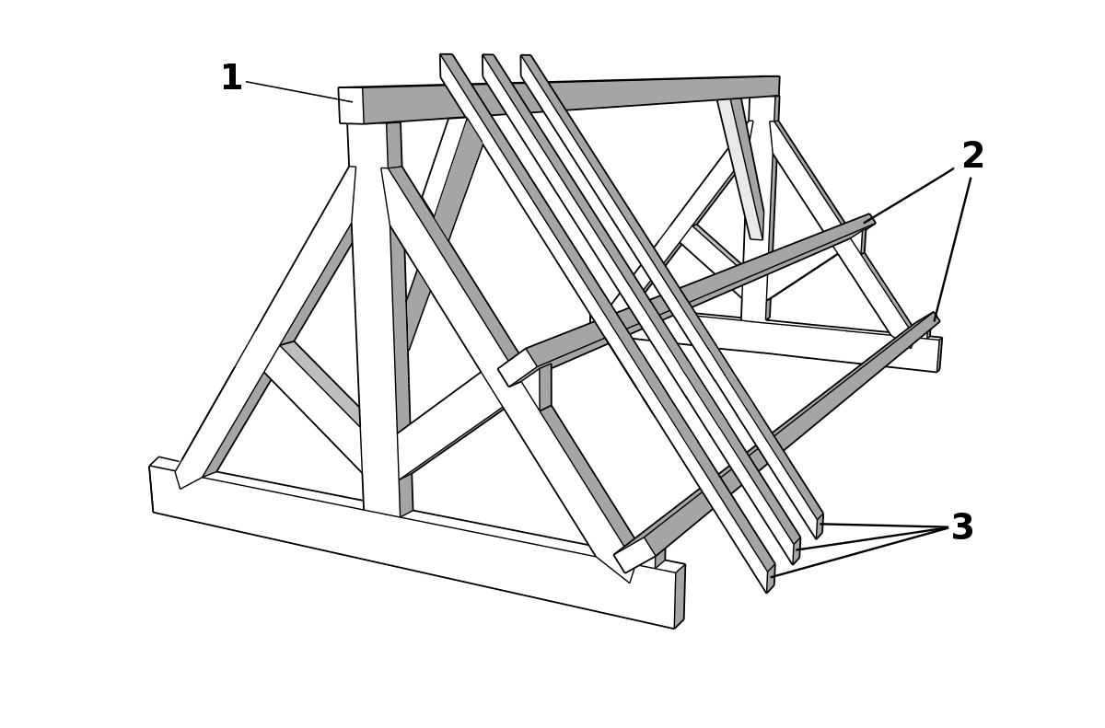
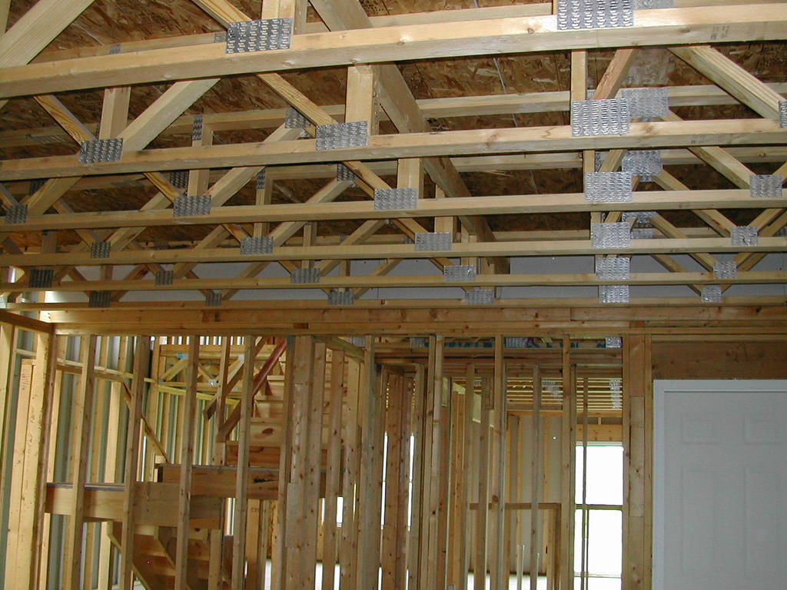
Rafters
Truss

Slide 10
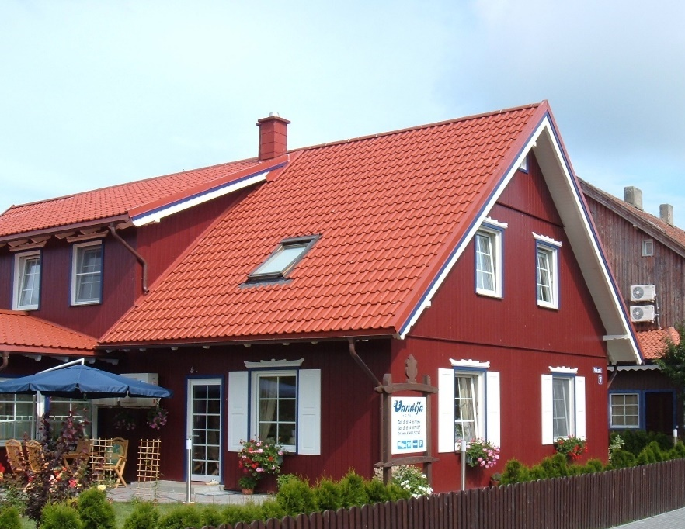
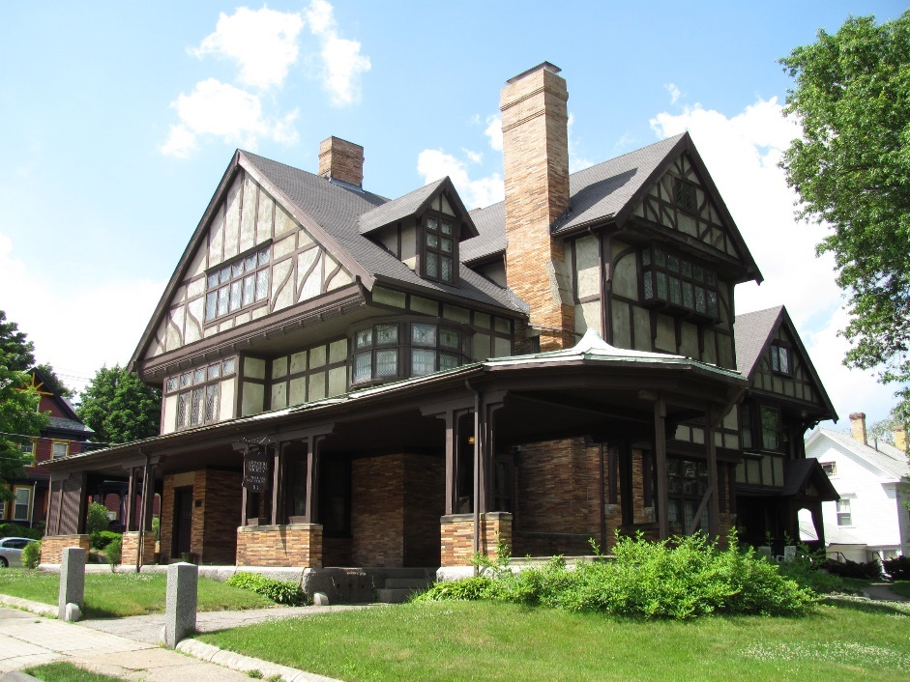
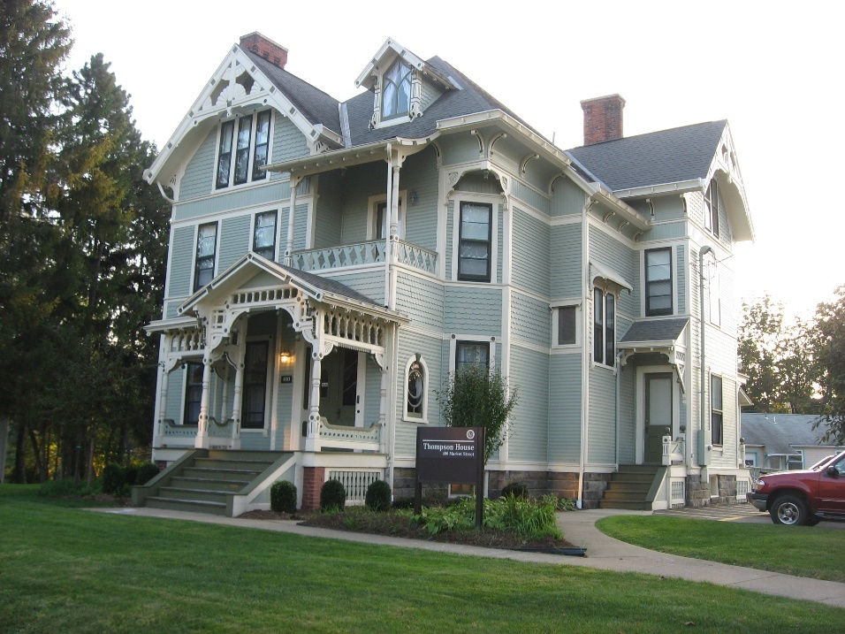
Fashion – Sensible rafter design

Slide 11
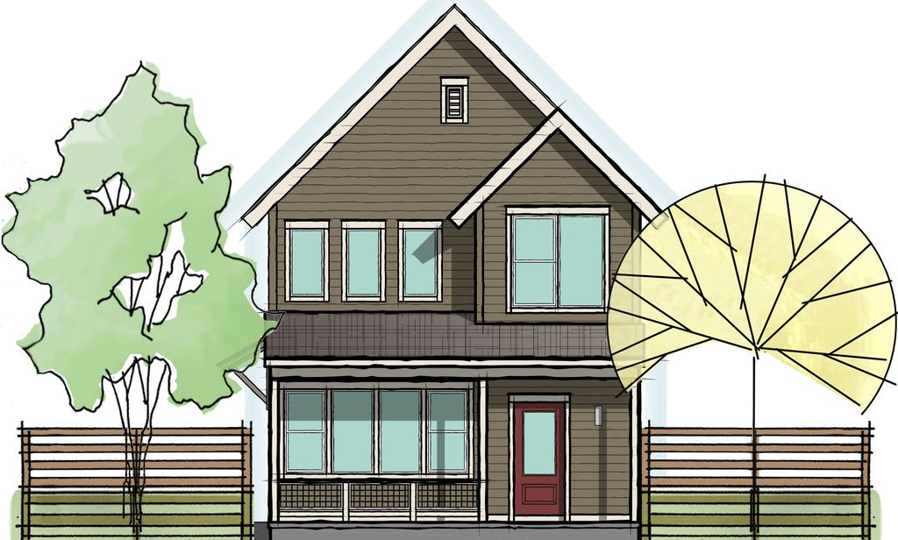
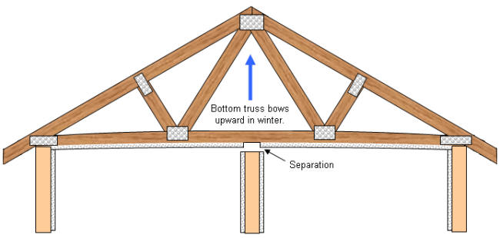
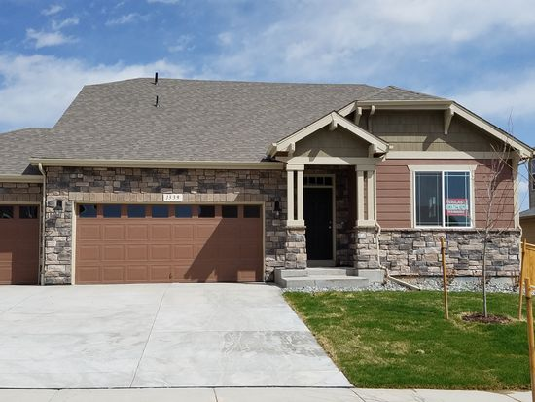
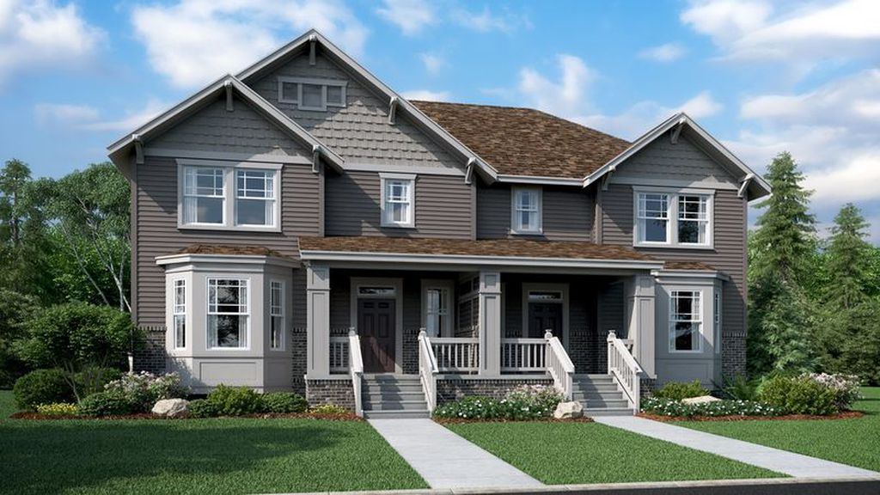
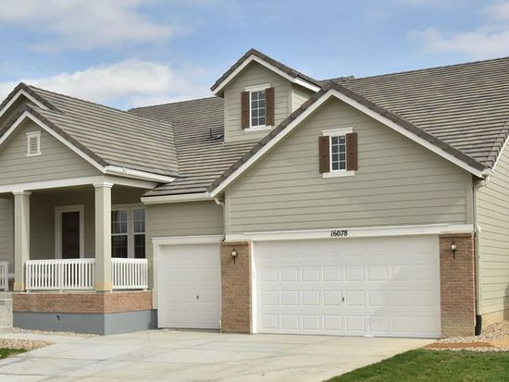
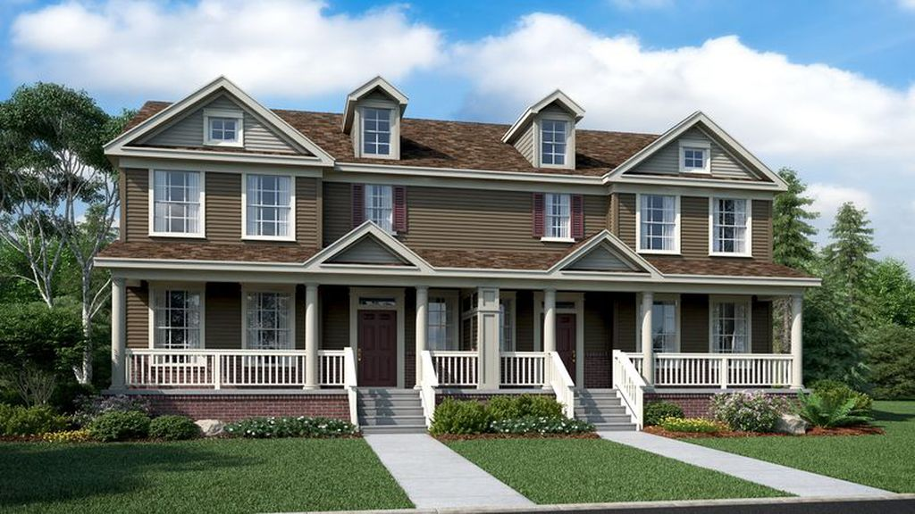
Fashion – And when you use trusses

Slide 12




Pockets

Slide 13


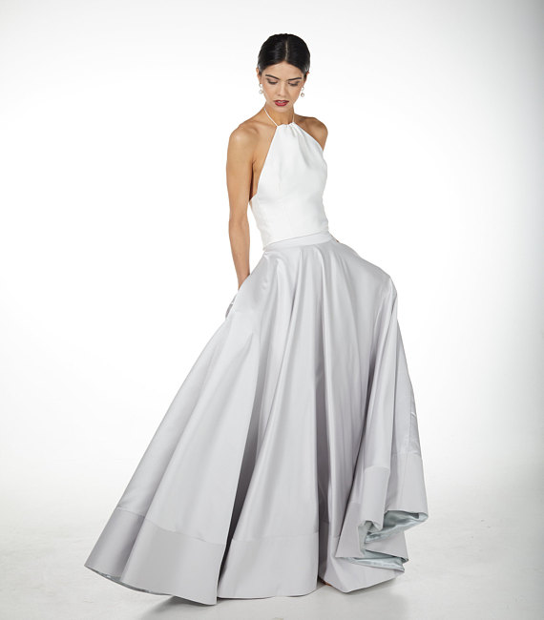
Etsy

Slide 14
Technology drives fashion - For the stupid - For the good

Slide 15
Pockets, not truss roofs

Slide 16
We have a desire for functional
Functional includes cultural change
Fashion can add real value, or not
Explore and experiment

Slide 17
What is a Functional Language?
Functional Language
Object Oriented Language
Central construct is a function
Functions are first class citizens
Central concept is a class
Functions may be (or may not be) first class citizens

Slide 18
Bigger distinctions
Dynamic vs Strong/static typing
JavaScript vs Haskell and C#
Compiler intensity (policing)
JavaScript vs Haskell and C#
Compiled vs. interpreted
C# vs Visual Basic for Applications (VBA)
Support for REPL
PowerShell or F# (C# Interactive)

Slide 19
Why functional in an OO world?
Testability
Parallelism
Reuse
Expressiveness
Reasonableness
Purity
Immutability
Inheritance, helper classes
Less smelly
Craftsmanship (naming, SRP, etc)

Slide 20
Why C# with Functional
Lots of usage (your team might be using it)
Best of strong typing to reduce accidents
But that’s noise!
Inference and implicit operators
Generics to reuse types
Extension methods to extend types
Functions first class citizens (strongly typed delegates)
Expressions trees: a structure to describe delegate contents
Keep the best of this, add more…

Slide 21
Why functional?
Testability
Parallel
Reuse
Expressiveness
Reasonableness
Purity
Immutability
Inheritance, helper classes
Less smelly
Craftsmanship (naming, SRP, etc)

Slide 22
Purity
No surprises!
Should indicate all possible input/output
Same input should always result in same output

Slide 23
Demo!
Purity

Slide 24
Purity
No surprises!
Should indicate all possible input/output
Same input should always result in same output
Control flow should be entirely predictable
Careful planning for exception
Void methods (except those doing absolutely nothing) are not pure
Pure code is easy to test
Be clear within your project what “the world can’t change” means

Slide 25
Purity is rather boring

Slide 26


Your app might look like...

Slide 27
Pure
Functional
World

Slide 28
Separate pure and not pure code

Slide 29
Pure
Functional
World
Pure
Functional
World
Pure
Functional
World
Pure
Functional
World
Pure
Functional
World

Slide 30

C#
Functional techniques

Slide 31
C# is statically typed and allows multiple internal functional islands
Pure
Functional
World
Pure
Functional
World
Pure
Functional
World
Pure
Functional
World
Pure
Functional
World
Pure
Functional
World
Pure
Functional
World
Pure
Functional
World
Pure
Functional
World

Slide 32
The ability to test is a measure of architectural sanity
Pure
Functional
World
Unit tests within pure units
Automated functional tests between units
Don’t mingle pure and impure code
Don’t mingle unit and functional tests
Confusing, since we refer to our automated test tools as unit test tools

Slide 33
Separate pure and not pure code

Slide 35
Separate pure and not pure code

Slide 37
Separate pure and not pure code

Slide 38
C# 7 and functional constructs (opinion)
First class functions
Purity
Immutability
OOP
Strong typing
Generics
Pattern matching
Expression Trees
Duck typing
Records

Slide 39
C# 7 and functional constructs (opinion)
First class functions |  | A-
Purity |  | D
Immutability |  | B-
OOP |  | A
Strong typing |  | A
Generics |  | A
Pattern matching |  | C
Expression Trees |  | A
Duck typing |  | F
Records |  | F

Slide 40
Functions as first-class citizens
Define functions (like data)
Pass functions around (like data)
Support higher order functions
Functions with delegate parameters or return delegates
In C# (and Visual Basic) this means Delegates

Slide 41
Delegates – functions as data
Generic delegate types (Action, Func)
Type safe function pointers
System.Delegate and inherited types
“Named” in docs
Anonymous methods
delegate()
Reference to a method (name without parens)
Can be a local method
Lambdas

Slide 42
Delegates – functions as data
Generic delegate types (Action, Func)
Type safe function pointers
System.Delegate and inherited types
“Named” in docs
Anonymous methods
delegate()
Reference to a method (name without parens)
Can be a local method
Lambdas

Slide 43
Demo!
Lambda
Function
Local Function

Slide 44
f Delegate Lambda func
Are the same in today’s context

Slide 45
Delegates are code fragments that can be stored to execute later
Func<T>
Func<T<T1<T2>>>
Func<T1, T2>
Func<TParam, T<T1<T2>>>
Func<int, Task<DataResult<List<Student>>>>
=>
Func<int, int> f1 = x => x + 2;
Func<int> f2 = () => 42;
Func<int, int, int> f3 = (x, y) => x + y;
...Where<T>(Func<T, bool> predicate)
var y = list.Where(z => z.Id == x);

Slide 46
LINQ
Select, Where, OrderBy etc. are higher order functions
They are pure because they return a new list
Lambdas are not free, especially with closures
var x = 42;
var y = list.Where(z => z.Id == x);
In memory loops are faster in high performance code (like .NET framework)
For your code, they are almost certainly close enough to free
Expression trees contain code definition
Can be understood in different languages
Like TSQL

Slide 47
Action: Delegates that don’t return a value
Action<T>
Action<T<T1<T2>>>
Not pure (unless trivial)
Doesn’t interchange with Func (not polymorphic)
...RecordTime<T>(Func<T> op)
...RecordTime<T>(Func<T, T2> op)
…
...RecordTime<T>(Action<T> op)
...RecordTime<T>(Action<T, T2> op)
Arity

Slide 48
Demo!
Converting Delegates to each other

Slide 49
Can convert delegate types to each other
public static class ActionExt
{
public static Func<VoidType> ToFunc(this Action action)
=> () => { action(); return VoidData; };
public static Func<T, VoidType> ToFunc<T>(this Action<T> action)
=> x => { action(x); return VoidData; };
public static Func<T1, T2, VoidType> ToFunc<T1, T2>(
this Action<T1, T2> action)
=> (T1 x, T2 y) => { action(x, y); return VoidData; };
}

Slide 50
Action: Delegates that don’t return a value
Action<T>
Action<T<T1<T2>>>
Not pure (unless trivial)
Doesn’t interchange with Func (not polymorphic)
...RecordTime<T>(Func<T> op)
...RecordTime<T>(Func<T, T2> op)
…
...RecordTime<T>(Action<T> op)
...RecordTime<T>(Action<T, T2> op)
Or just generally avoid Action

Slide 51
Refactoring to Functional

Slide 52
Imperative (normal) Refactoring
Inside out refactoring
Grab some code
Make a new method
Use it multiple places

Slide 53
Imperative Refactoring

Slide 54
Imperative Refactoring

Slide 55
Demo!
Inside out refactoring (normal)

Slide 56
Functional Refactoring
Outside in refactoring
Grab the outside code
Make a new method
Pass the inside code
Use it multiple places

Slide 57
Functional Refactoring

Slide 58
Imperative Refactoring
=>

Slide 59
Functional Refactoring
=>

Slide 60
Functional Refactoring
=>

Slide 61
Demo!
Outside in refactoring

Slide 62
Handling Errors

Slide 63
What could possibly go wrong?
Protocol failure like routing (one, not seen by app)
Unpacking behavior like bad JSON format (one, seen by infrastructure)
Validation like string too long (many)
Anticipated environment issues like database missing (one, 📞 ops)
Unexpected app failure like null reference (one, 📞 programmers)
Batch process, last 3 above for each item
All succeed
Some succeed
None succeed

Slide 64
WebAPI External facade
Service Business logic
Repository Persistence
RichData
RichData

Slide 65
WebAPI External facade
Service Business logic
Repository Persistence
RichData (NO Exception)
RichData (NO Exception)

Slide 66
Naming is hard
Either
RichData
Result
Try
Validation<Exception<T>>
?
1) Core FP concept, 2 & 3) Kathleen 4) Sander (if I understand his abstract) 5) Enrico

Slide 67
Naming is hard
Either
RichData
Result
Try
Validation<Exception<T>>
?
1) Core FP concept, 2 & 3) Kathleen 4) Sander (if I understand his abstract) 5) Enrico

Slide 68
WebAPI External facade
Service Business logic
Repository Persistence
RichData (NO Exception)
RichData (NO Exception)

Slide 69
Your app might look like...

Slide 70
Your app might look like...
What?
Cats?
Cloud?
GIFs?
This talk seems to be lacking something

Slide 71

Your app might look like...
This Photo by Unknown Author is licensed under CC BY
This Photo by Unknown Author is licensed under CC BY
This Photo by Unknown Author is licensed under CC BY

Slide 72
Your app might look like...
Validation
Business logic
Map entity to domain

Slide 73
Your app might look like...
Your App
Validation
Business logic
Map entity to domain
Architecture

Slide 74
Validation
Business logic
Map entity to domain
Nothing
Validation
Dev Error
Ops Error
Warning
Info
Outcome
User Message
Log Message
Data

Slide 75
Demo!
Outcome
RichData<TData>

Slide 76
Useful things in C#
Expression-body members
Generic inheritance hierarchies
Expression trees
Local functions
Pattern matching (enhanced switch statement)
Tuples
Throw expression
Pattern matching (switch expression)
Default interface implementation (rich interfaces)
8

Slide 77
Expression-body members
public (IEnumerable<string> messages,
int staffCount,
int) GetThankYouMessages(IEnumerable<Person> persons)
=>
(
persons.Select(x => GetThankYouMessage(x)),
persons.Where(x => x is Staff).Count(),
42
);

Slide 78
We need to be communicate intended purity
=>
Use expression body members
only when code is pure

Slide 79
Generic inheritance hierarchies from a partial application perspective
Base class has no generic type
Leaf class has all types
Each intervening class has a purpose and adds generic types

Slide 80
Abstract Get, GetAll, Create, Update, Delete
BaseRepository
Opinionated in single struct key
BaseRepository
<TDomain, TPKey>
Abstract GetWhere, GetAllWhere
Func properties Map…
BaseMappedRepository
<...TEntity>
Implementation of all except mapping
BaseEFRepository
<... TDbContext>
CourseRepository
Specific mapping and key definitions

Slide 81
Abstract Get, GetAll, Create, Update, Delete
BaseRepository
Opinionated in single struct key
BaseRepository
<TDomain, TPKey>
Abstract GetWhere, GetAllWhere
Func properties Map…
BaseMappedRepository
<...TEntity>
Can do JSON!
Implementation of all except mapping
BaseEFRepository
<... TDbContext>
CourseRepository
Specific mapping and key definitions

Slide 82
Demo!
How this works in an application

Slide 83
Recap

Slide 84

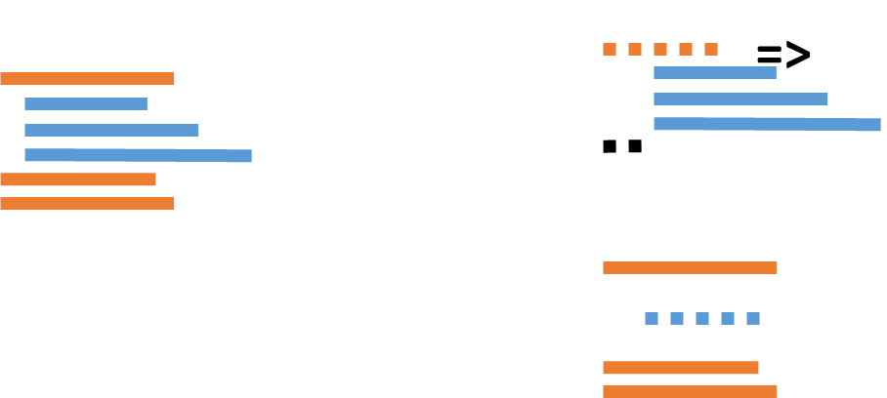
We have a desire for functional
Functional includes cultural change
Fashion can add real value, or not
Explore and experiment
C#
Functional techniques
Validation
Business logic
Map entity to domain
Pattern matching
Generic hierarchies
And much more
Pure
Pure
Pure
Pure
Pure
Rich Data
Exception/Info
Data

Slide 85
We have a desire for functional
Functional includes cultural change
Fashion can add real value, or not
Explore and experiment
C#
Functional techniques
Validation
Business logic
Map entity to domain
Pattern matching
Generic hierarchies
And much more
Pure
Pure
Pure
Pure
Pure
Validation
Dev Error
Ops Error
Warning
Info
Outcome
User Message
Log Message
Data

Slide 86
Questions? Functional Techniques for C# @kathleendollard kdollard@gmail.com
References
Today’s code: https://github.com/KathleenDollard/ClassTracker
Functional Programming in C#: How to write better C# code
Enrico Buonanna
Manning, 2017
Pluralsight : Applying Functional Principles in C#, Vladimir Khorikov
Pluralsight : Functional Programming with C#, Dave Fancher
Review of Bacus’s paper: https://medium.com/luteceo-software-chemistry

